Slide 1

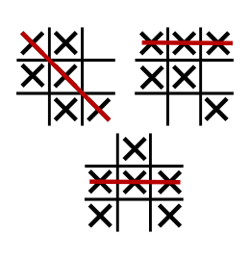
Tic-Tac-Toe
Classic 3 by 3 X and O grid game
By: Tobin Massie

